Slide 1

BFSI Pecunia Bank Case Study

Slide 2
Group 5
GROUP 6
Anish Basu
Anwesha Das
Arpan Mondal
Kumar Saurabh
Mansi Agarwal
Rishav Dev
Rohan Patil
Abhisek Kumar
Aditi Singh
Anindya Rana
Rishabh Rai
Rohit Kumar
Vidushi Razdan

Slide 3
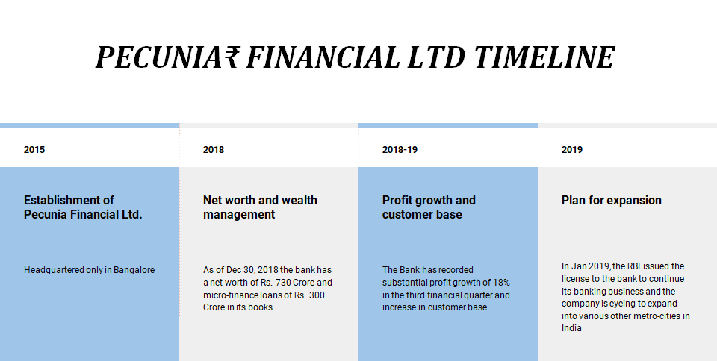

Slide 4
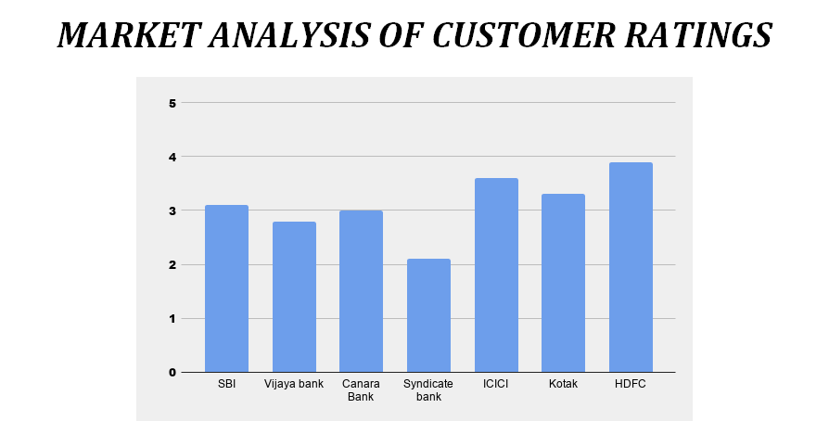

Slide 5
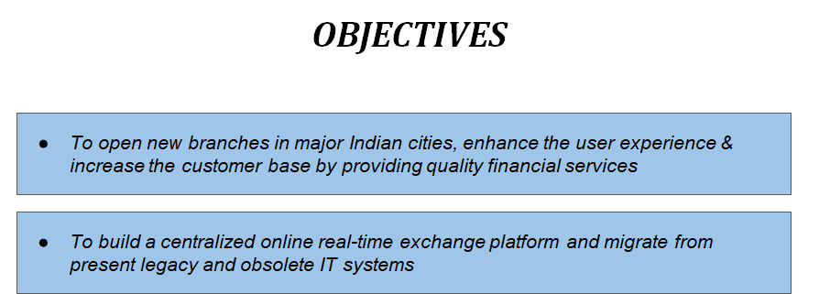

Slide 6
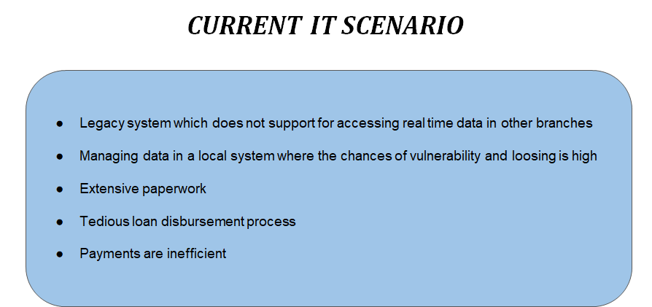

Slide 7
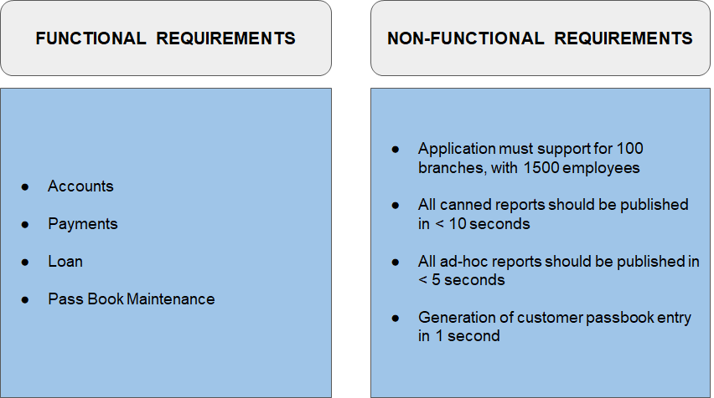

Slide 8
CLASS DIAGRAM

Slide 9
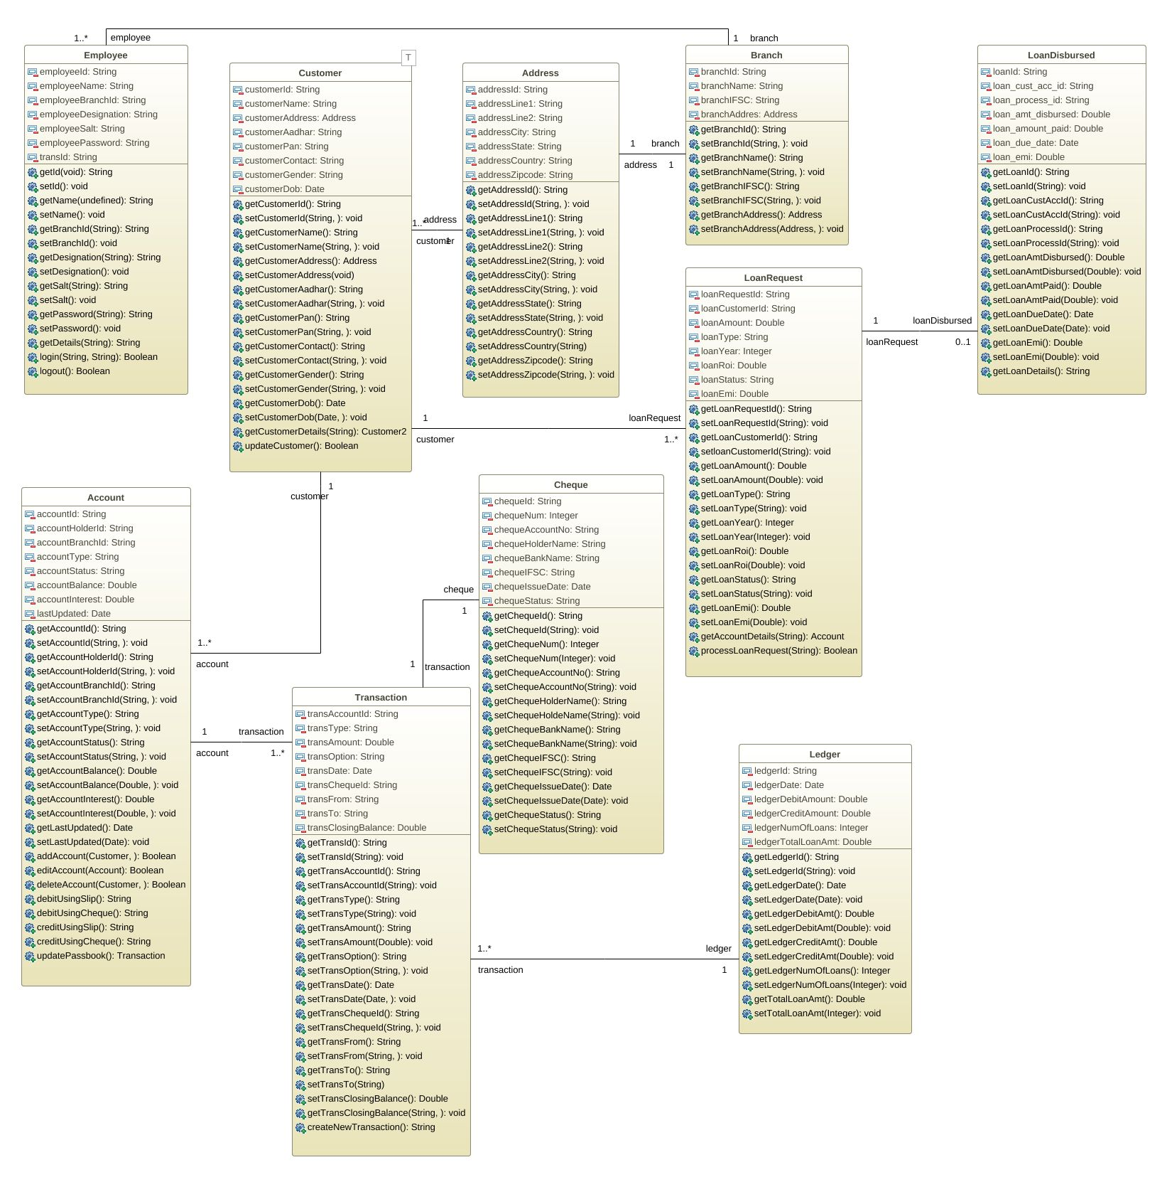

Slide 10
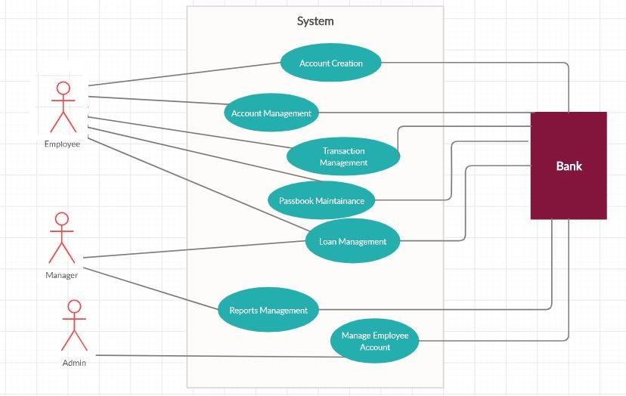
Overview Use Case Diagram

Slide 11
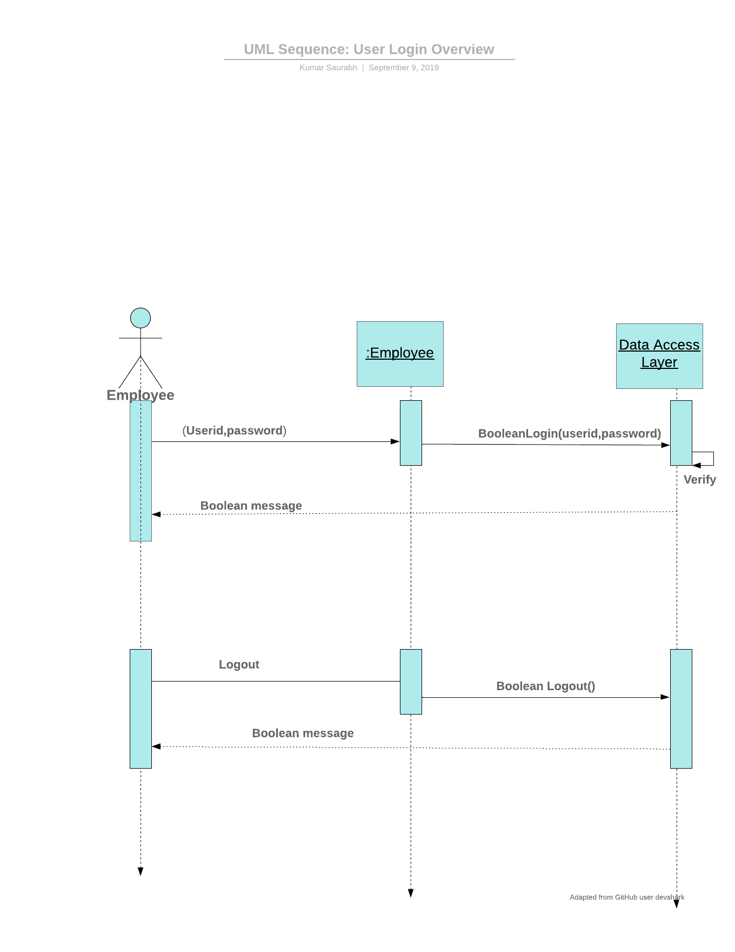
Login sequence diagram

Slide 12
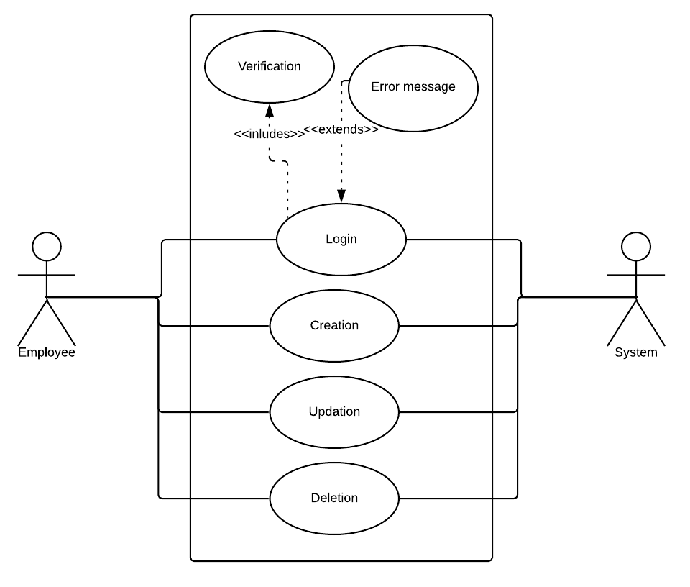
Account Creation Use Case

Slide 13
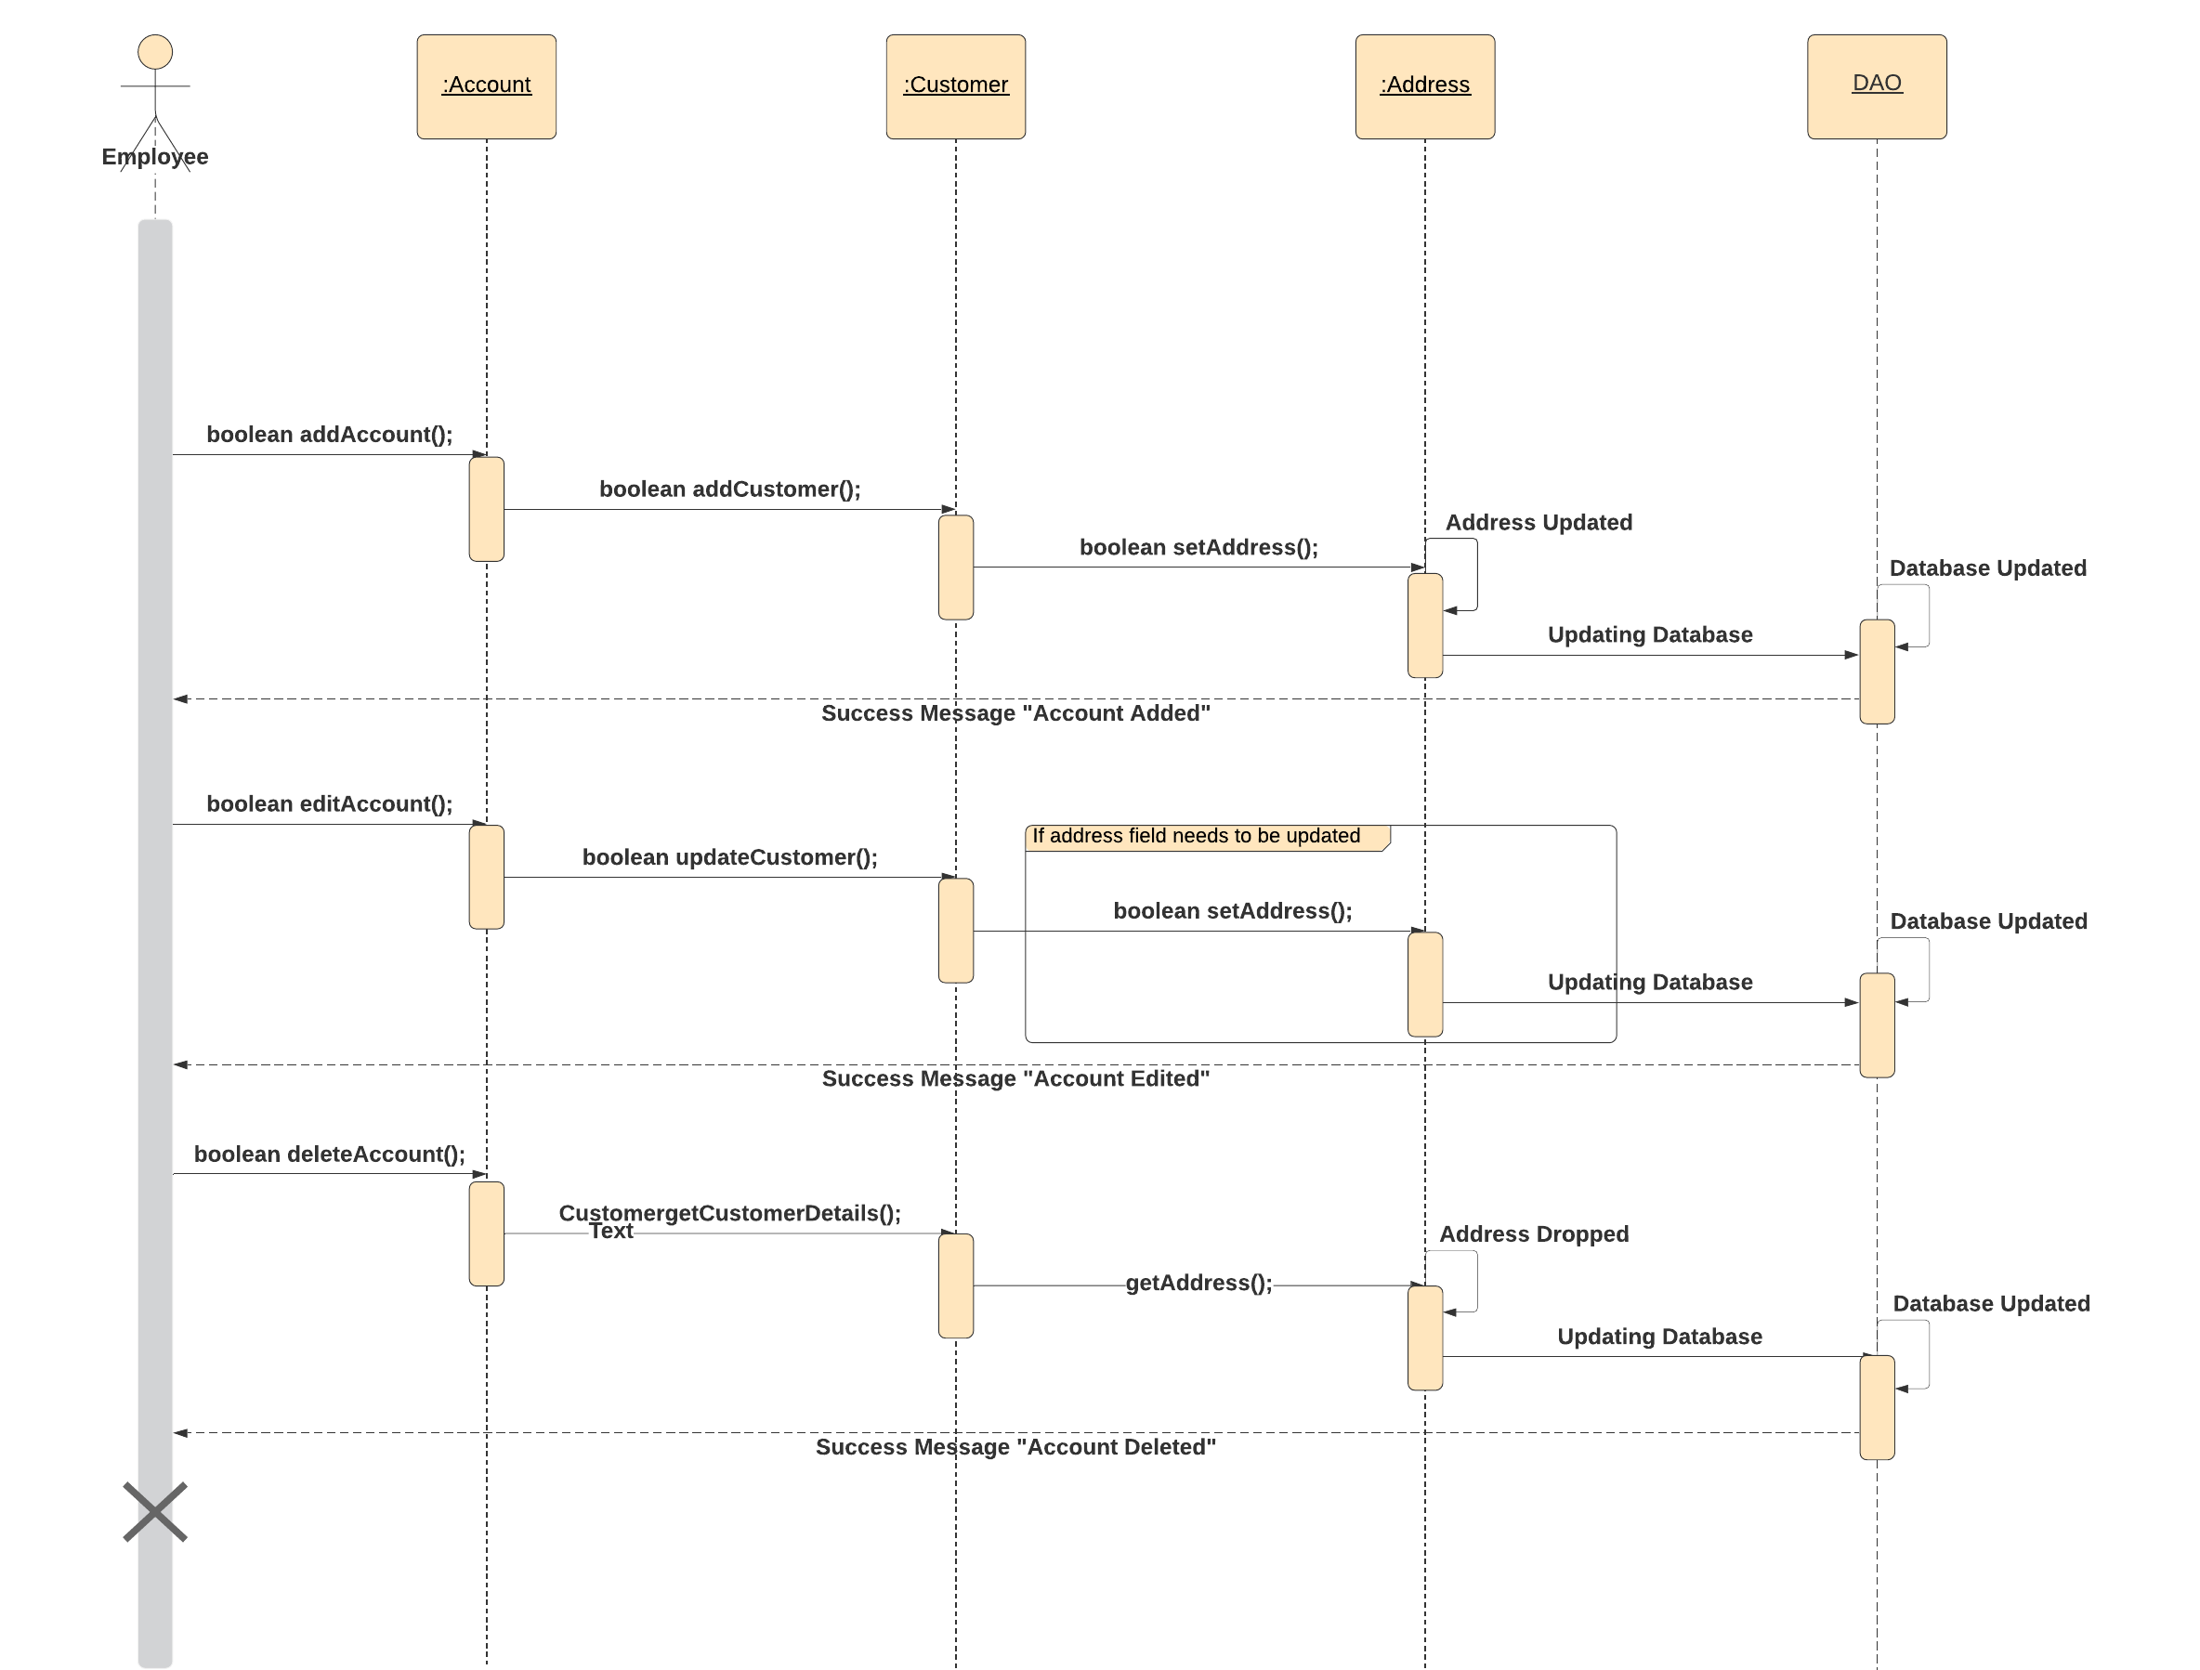
ACCOUNT CREATION SEQUENCE DIAGRAM

Slide 14
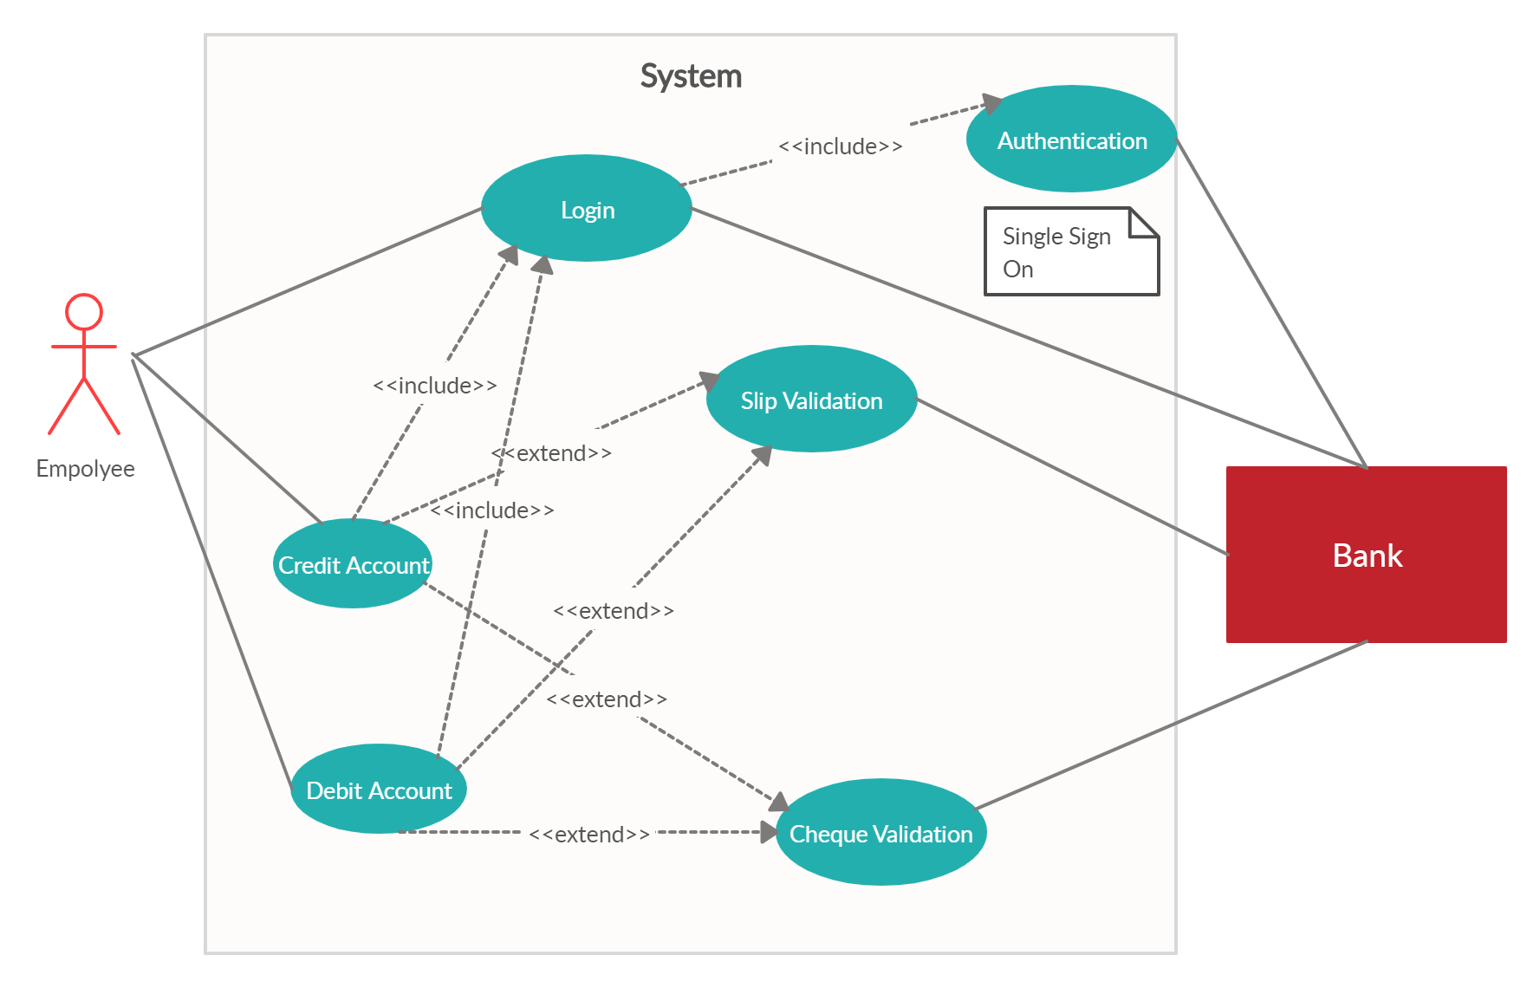
Payment Use Case Diagram

Slide 15
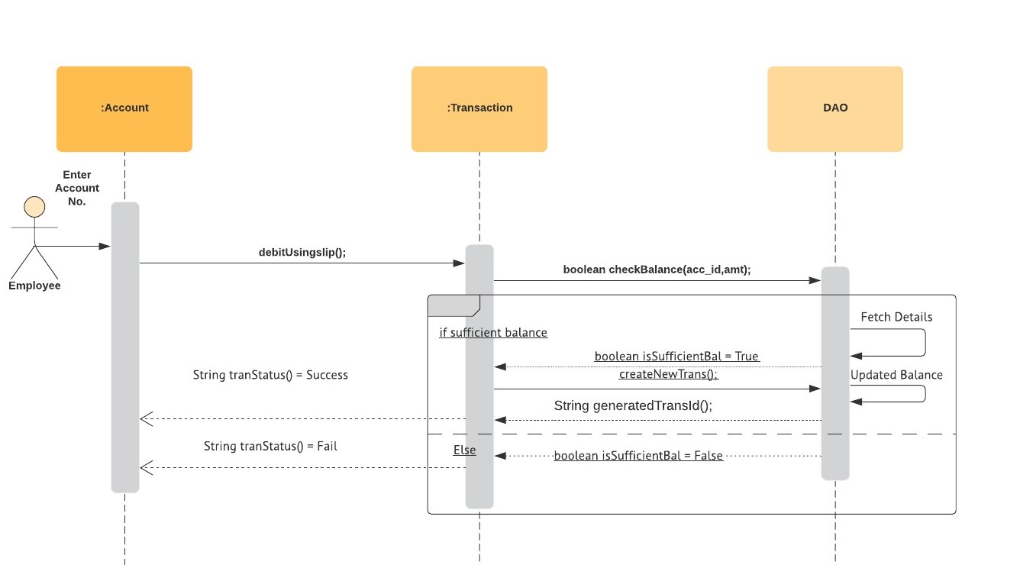
PAYMENT SEQUENCE DIAGRAM debit using slip

Slide 16
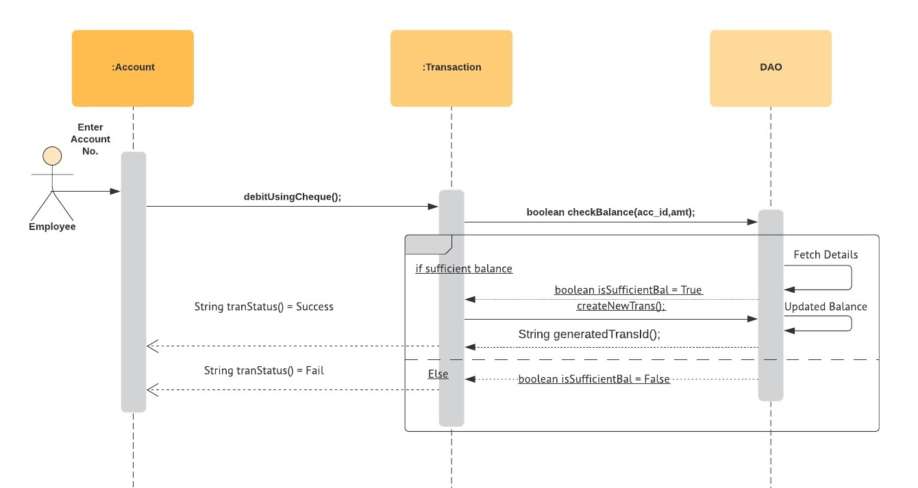
PAYMENT SEQUENCE DIAGRAM Debit using cheque

Slide 17
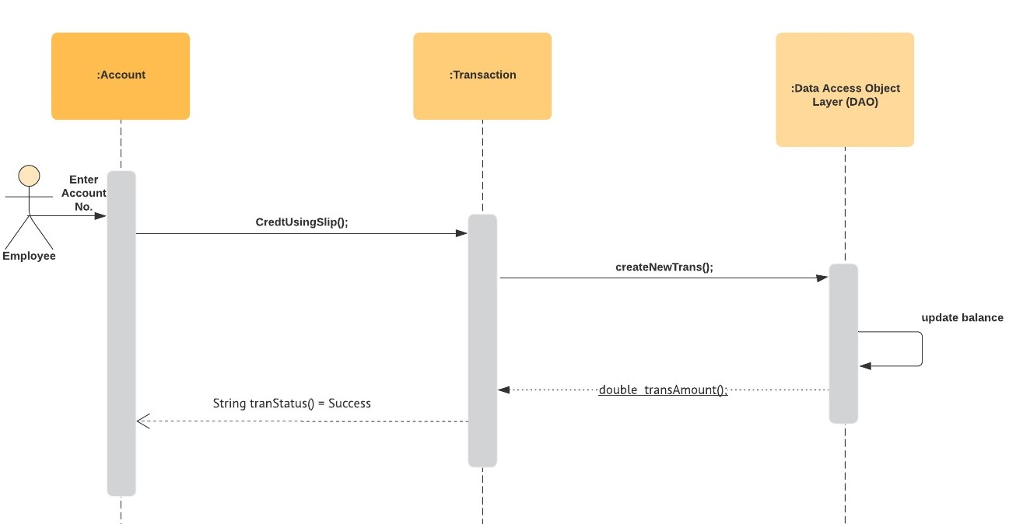
PAYMENT SEQUENCE DIAGRAM credit using slip

Slide 18
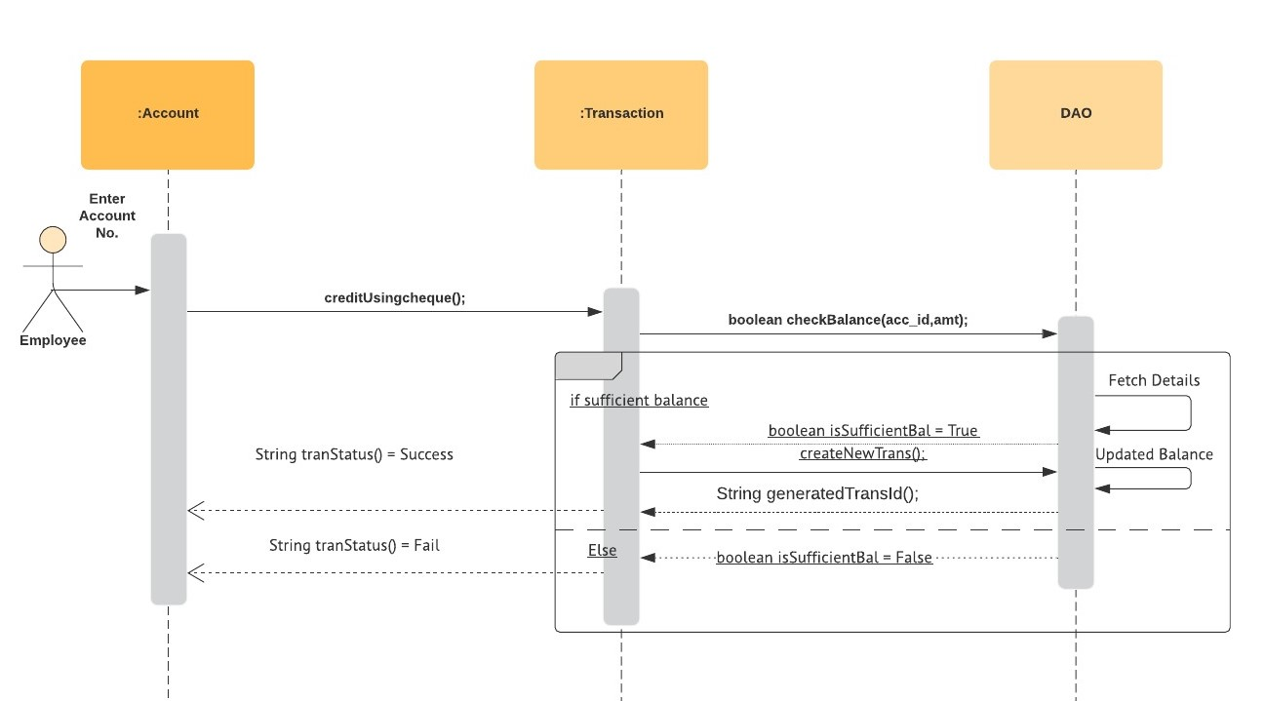
PAYMENT SEQUENCE DIAGRAM CREDIT USING cheque

Slide 19
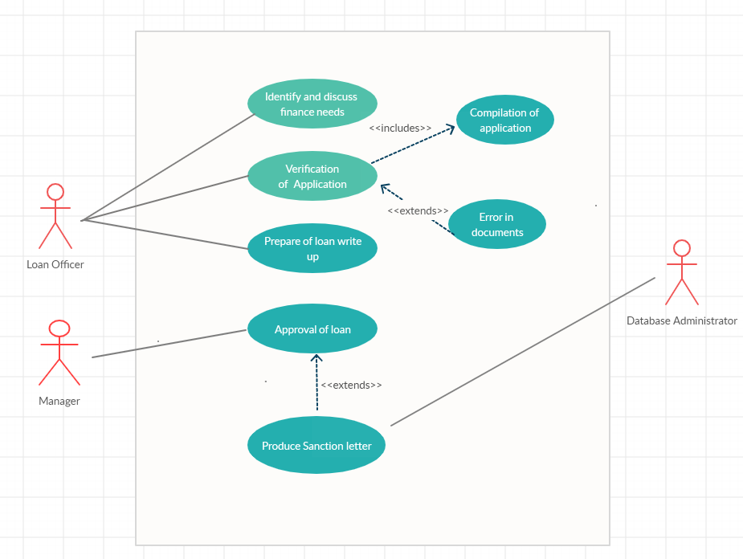
Loan Use Case Diagram

Slide 20
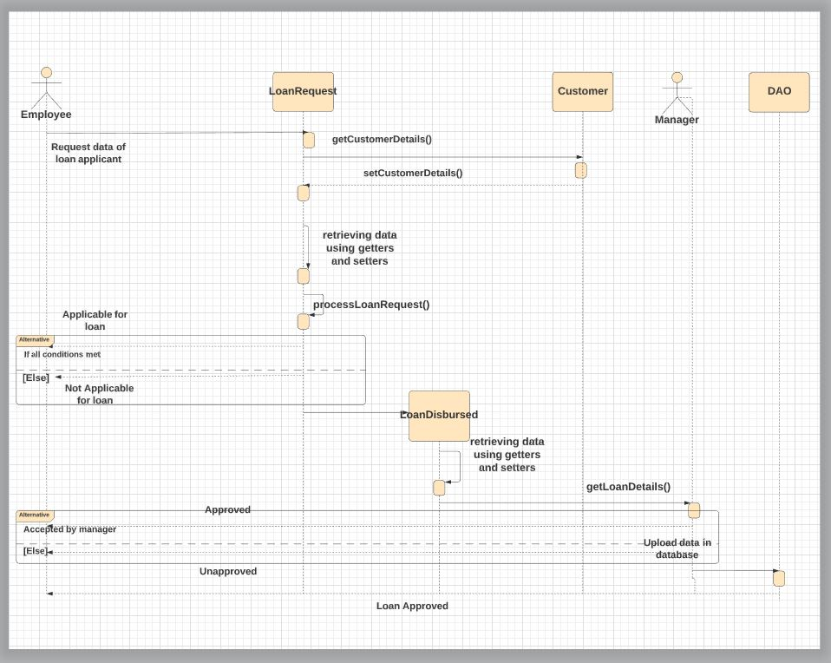
Loan Sequence Diagram

Slide 21
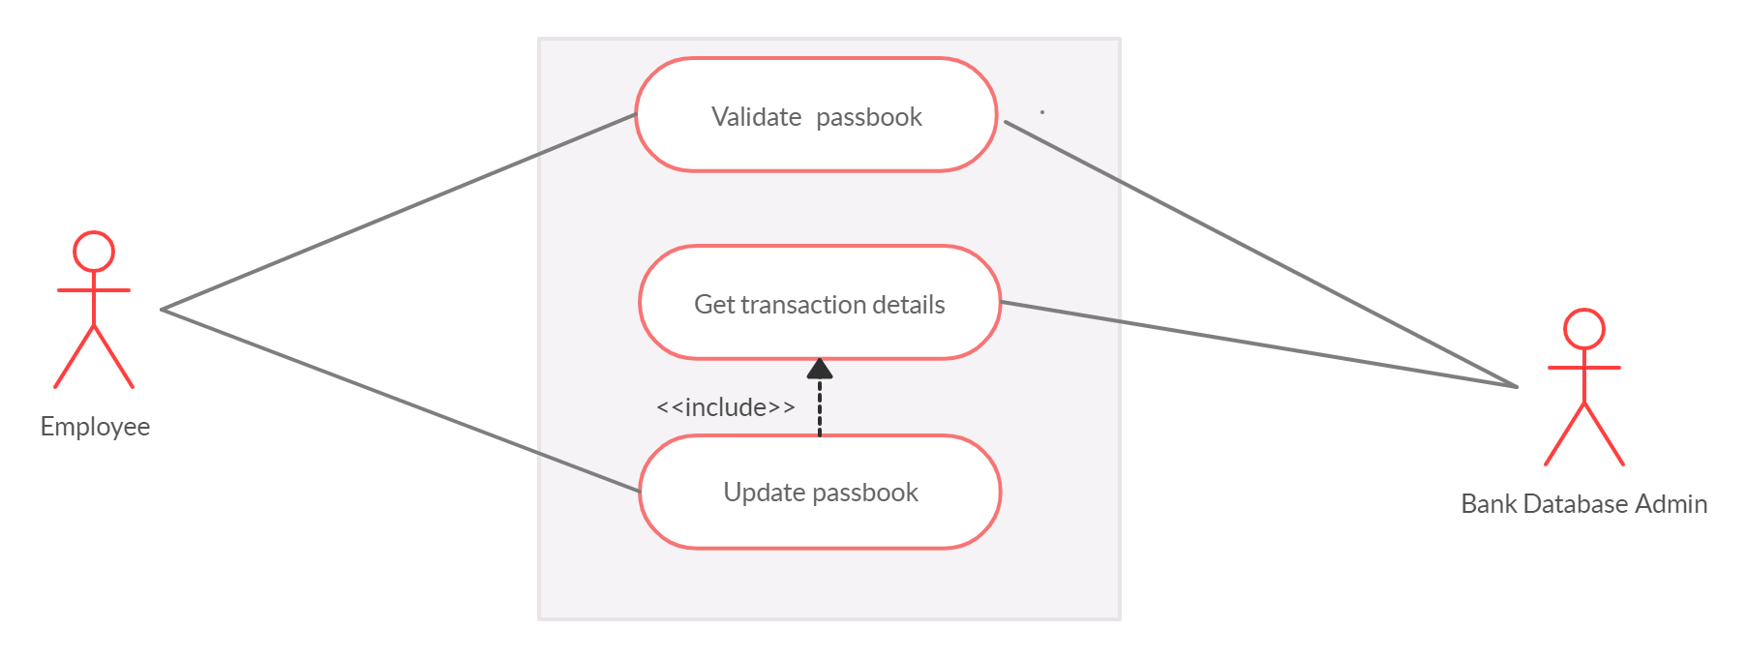
Use case diagram for passbook

Slide 22
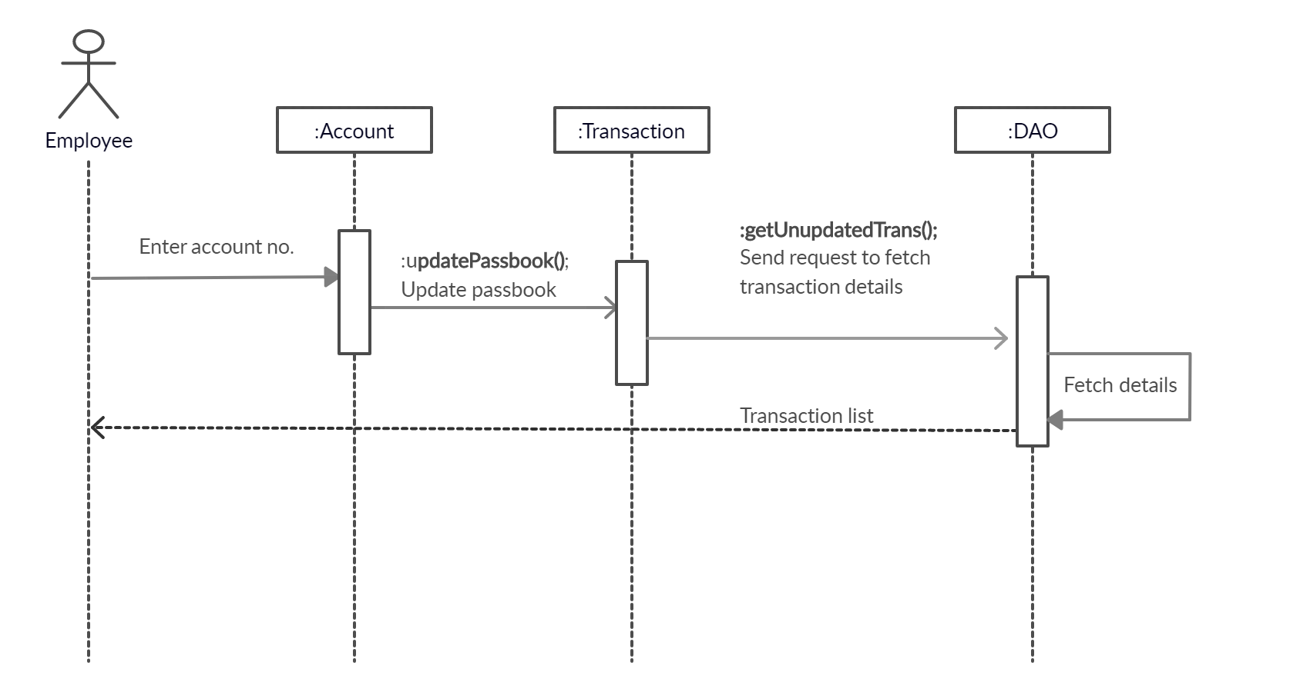
Passbook Sequence Diagram

Slide 23
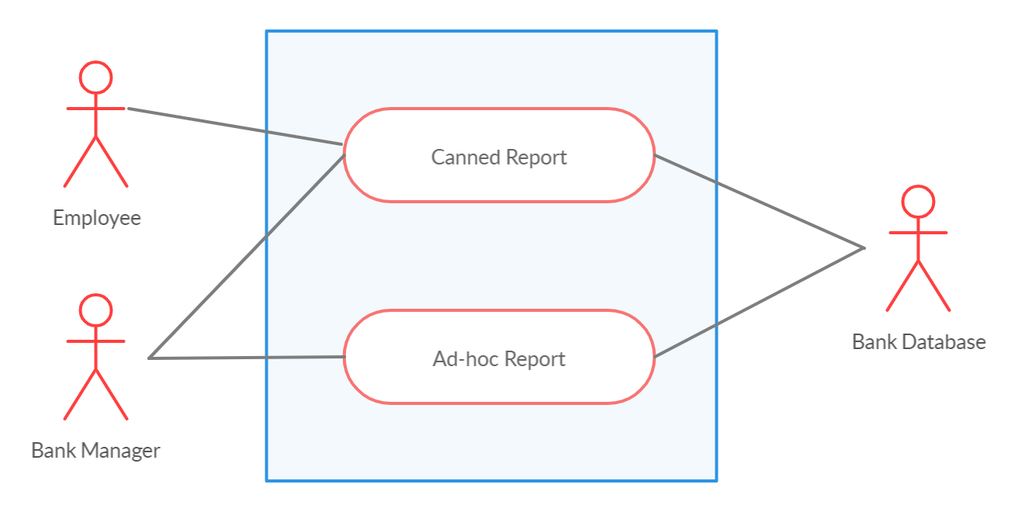
Ad – Hoc & Canned Reports Use Case Diagram

Slide 24
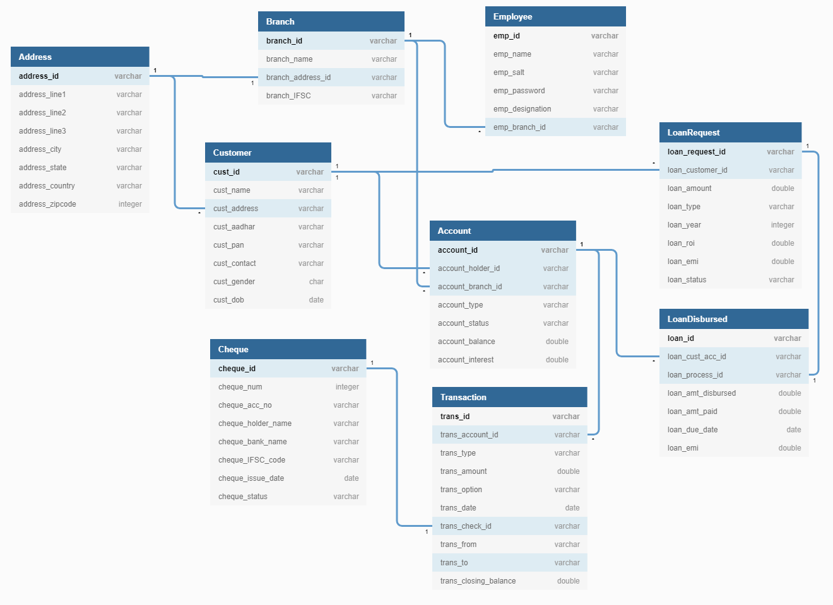
DB Schema

Slide 25
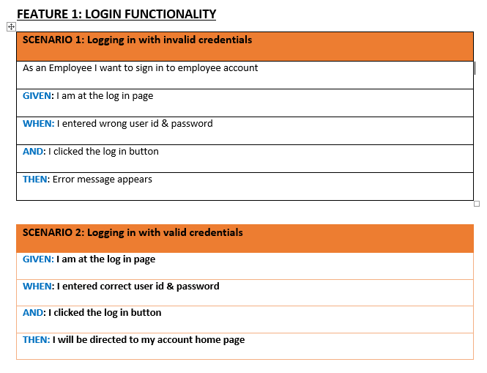
Test Case

Slide 26
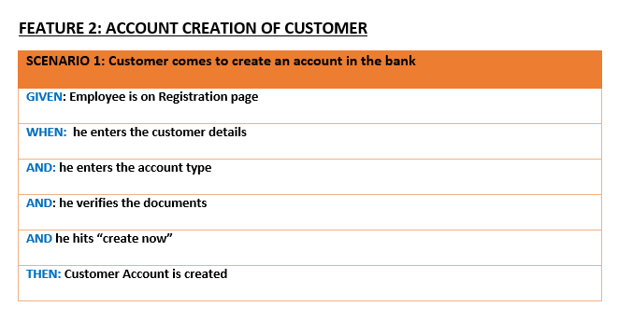
Test Case

Slide 27
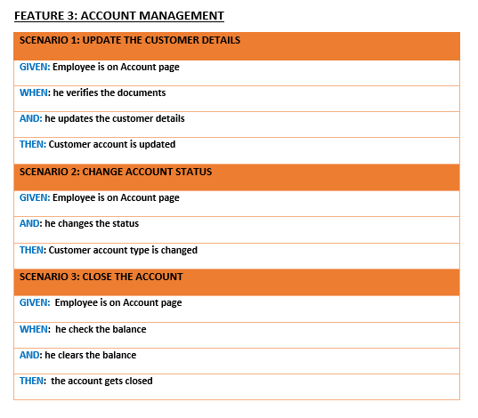
Test Case

Slide 28
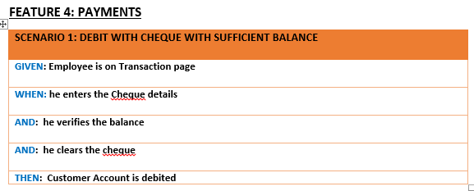
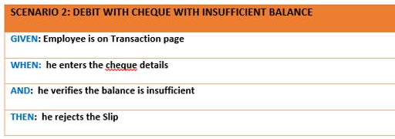
Test Case

Slide 29
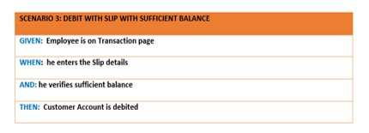
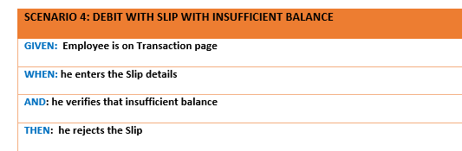
Test Case

Slide 30
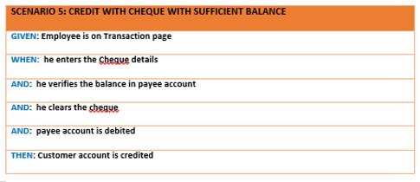
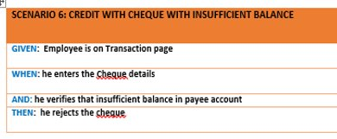
Test Case

Slide 31
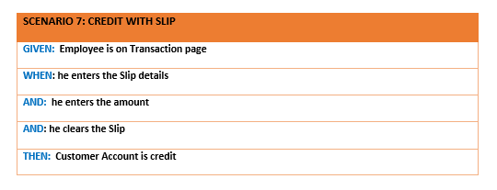
Test Case

Slide 32
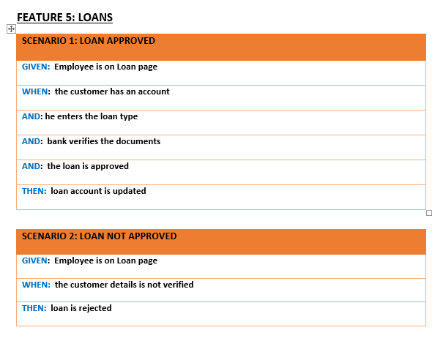
Test Case

Slide 33
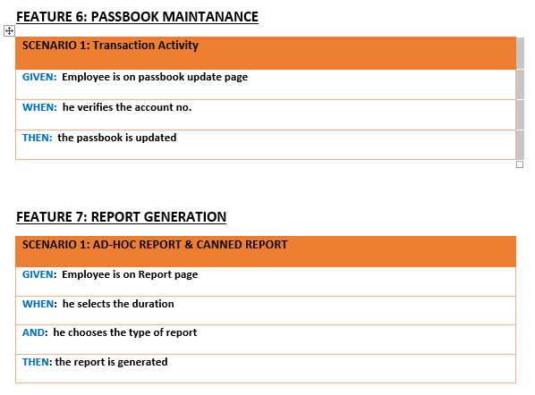
Test Case

Slide 34


